Slide 1



Pilot Network Introduction

Slide 2





FAC Pilot Network Overview
FAC is building an innovative distributed ledger-based platform for mutual funds servicing.
FAC is a private, permissioned network built on R3 Corda Enterprise.
FAC processes transactions and settles them. Both cash and fund assets are tokenised in FAC and transaction finality is achieved on ledger by atomic settlement (bilateral synchronised DvP).
The ledger is a series of independent nodes operated by an actor in the value chain.
Investor
Fund Servicing
Cash Exchange
Fund Manager

Slide 3
FAC Principal Value Chain
Issues cash tokens against
Delivered fiat currency
Holds fiat cash in safekeeping
Delivers fiat cash against cash token redemption
Validates orders, pricing, fund token issuance and settlement.
Oversight of investors orders
Using real time subs and reds data to manage fund liquidity
Tokenises cash to invest in funds
Investors
Fund Servicing
Cash Exchange
Fund Manager
FAC - Distributed Ledger Network
Data Sharing (register and transactions)
Token issuance and redemption (cash and fund)
Buying and selling fund tokens
Tokenised settlement
>>> Conversion to FIAT

Slide 4
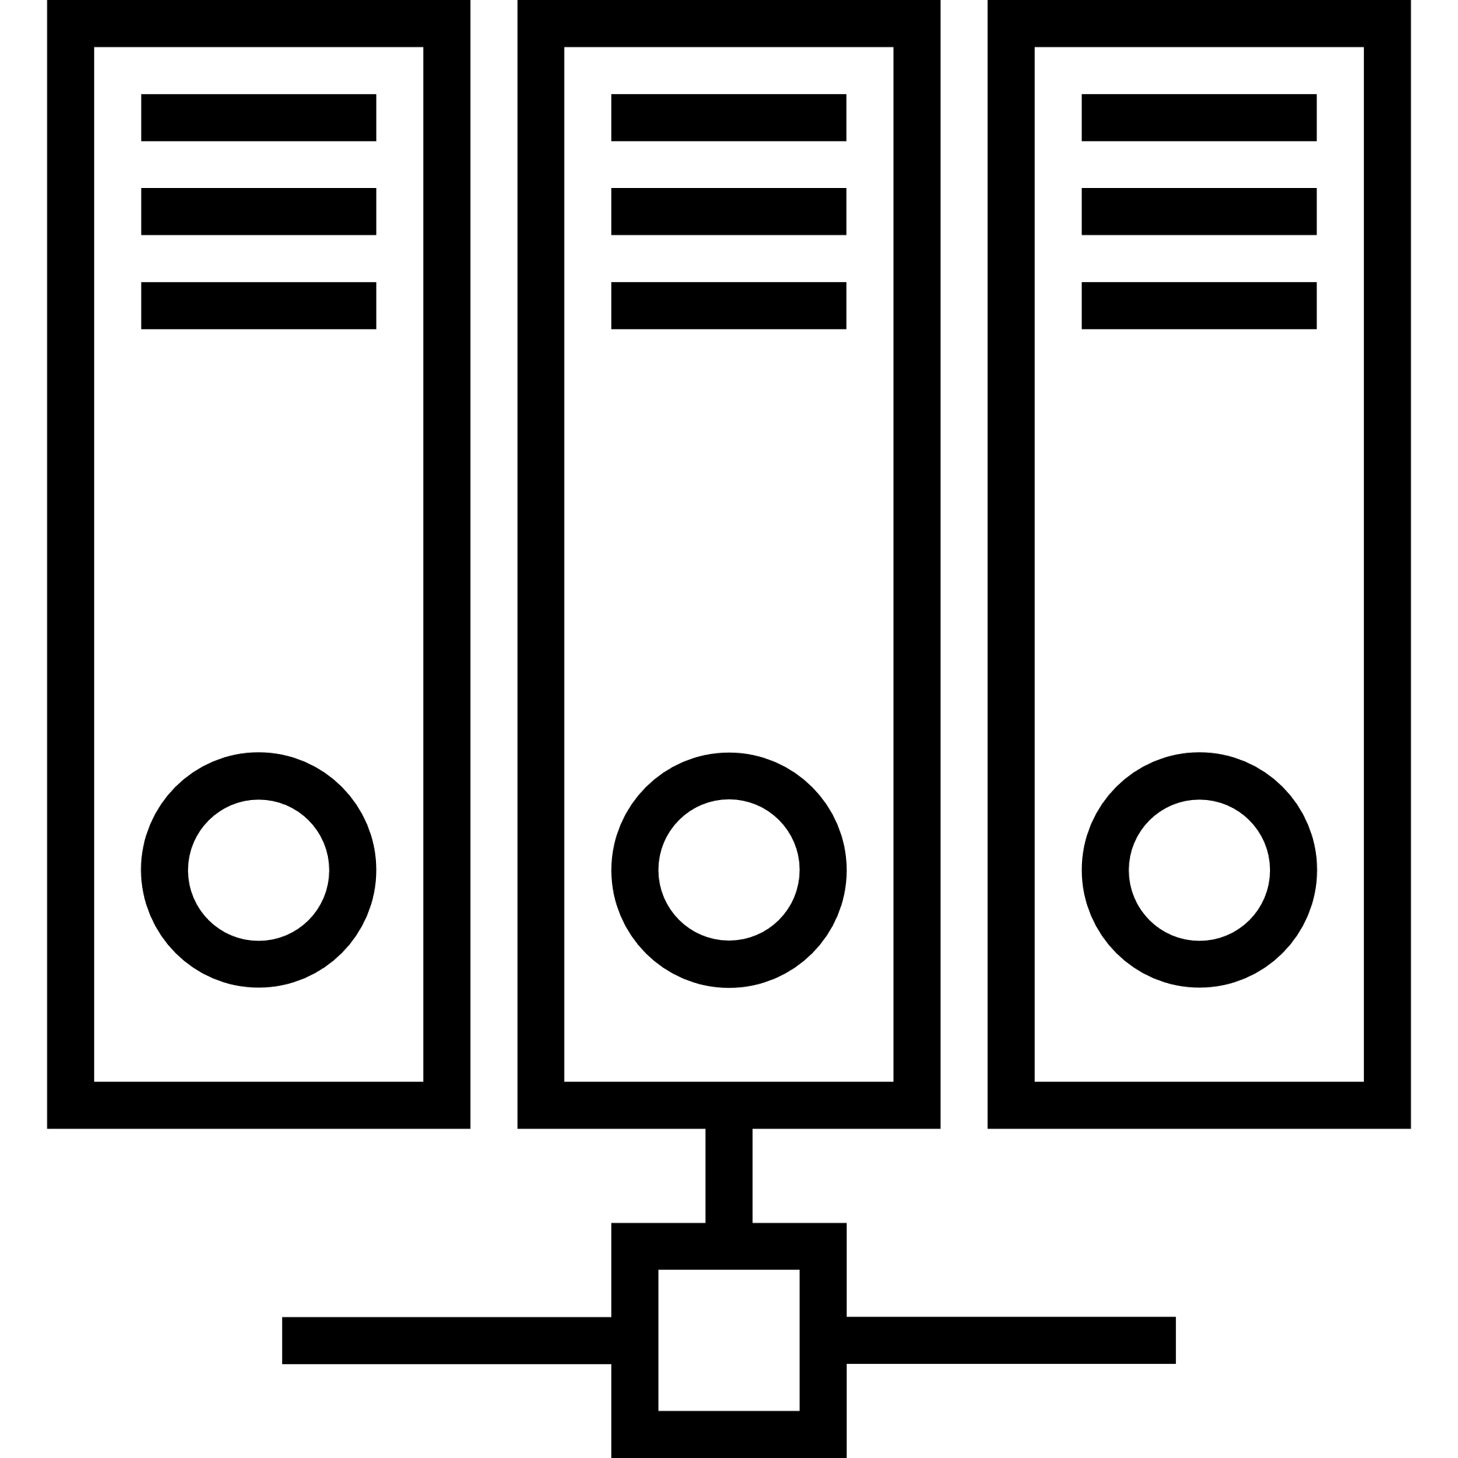
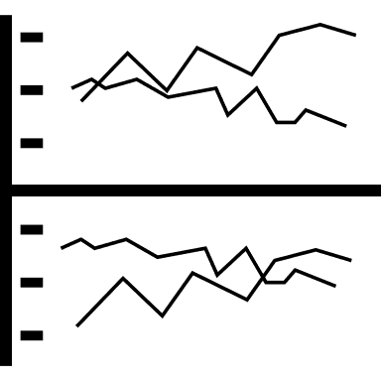




FAC Node Architecture
FAC User
Enterprise
Application
Data
Provider
Messaging
Network
Middleware
Web
Application
FAC DL Network
Datastore
Vault
CorDapp
Each participant has their own node on the network which is connected via the FAC distributed application (the CorDapp). Each node also has it’s own database, web application and connectivity to external systems
Report Server
FAC NODE

Slide 5







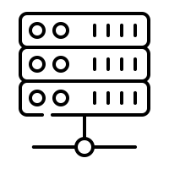
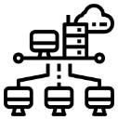
FAC Roles in Pilot Network
Fund Accountants
Fund
Servicers
Bank
Cash
Exchange
Fund Custodians
Off network
participants
On network
participants
Fund
Managers
Depositary
Some actors in the daily processes are not directly connected to the network but must still take part in the end to end workflows
Corda Services
Investors
Business
Network
Operator

Slide 6
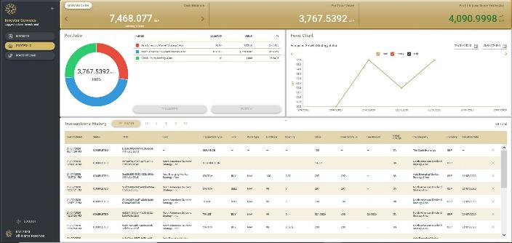
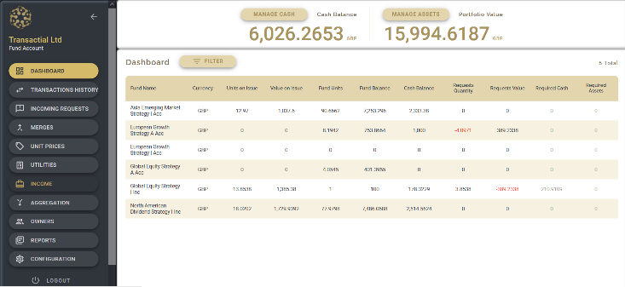
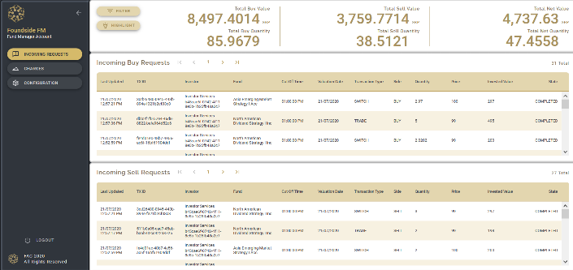
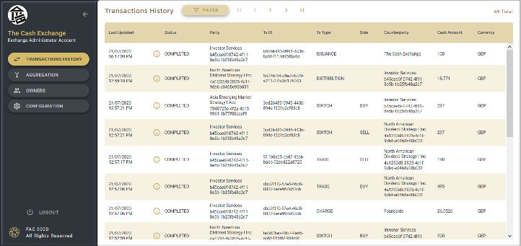
The FAC Web GUI
Users can access FAC nodes using a web based application.
Each node has it’s own interface with permissions configured to the role of the node (i.e. only a fund servicing node can price a trade)
Using the web interface users on different nodes can take part in the end to end workflow.
Fund
Servicing
Node
Investor
Node
Fund
Manager
Node
Cash
Exchange
Node

